Slide 2
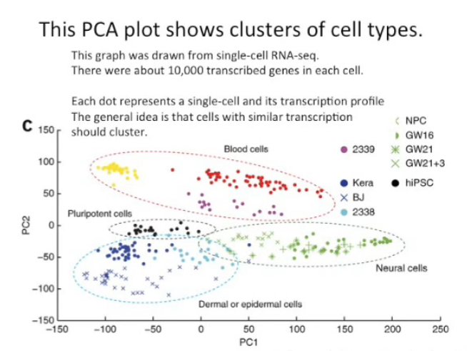

Slide 3
The PCA plot shows clusters of cell types
How does transcription from 10,000 genes get compressed to a single dot on a graph?
PCA is a method for compressing a lot of data into something that captures the essence of the original data

Slide 4
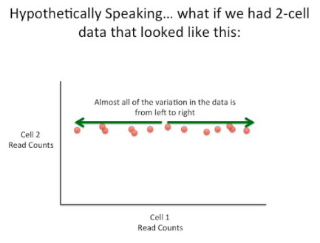

Slide 5
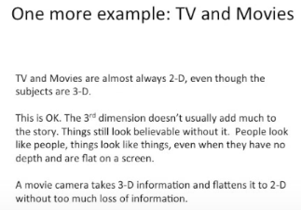

Slide 6
Dimensions
Each feature we sequence adds another dimension
Some dimensions are more important the others

Slide 7


Slide 8
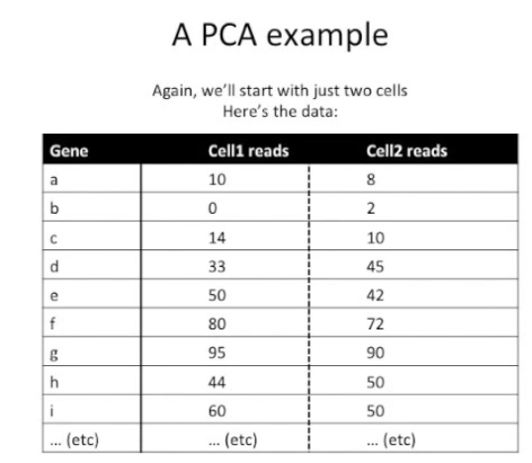

Slide 9
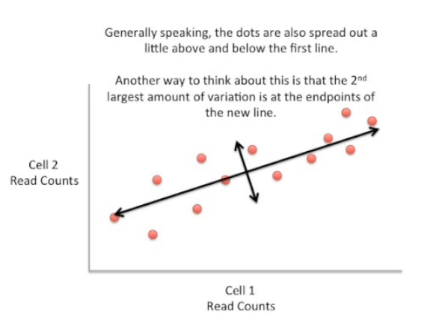

Slide 10
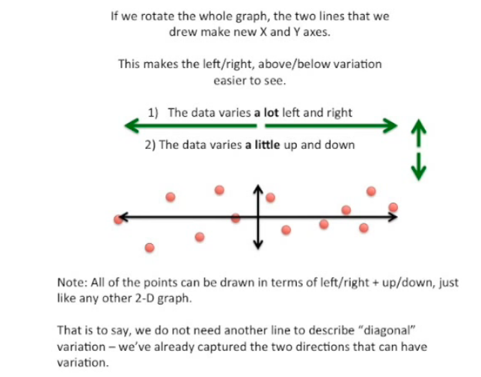

Slide 11
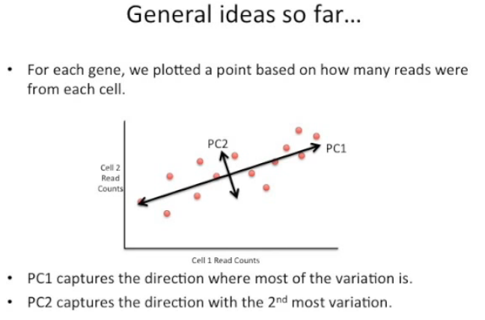

Slide 12
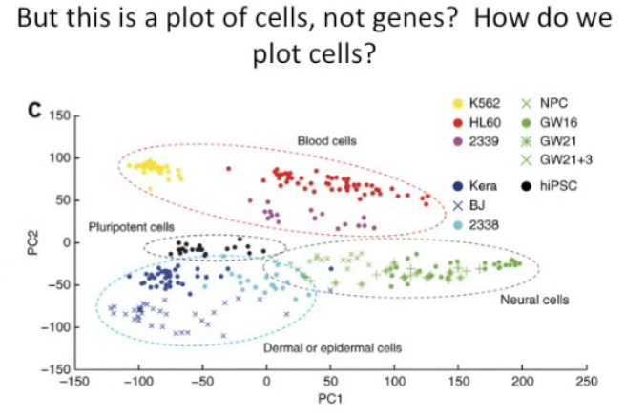

Slide 13
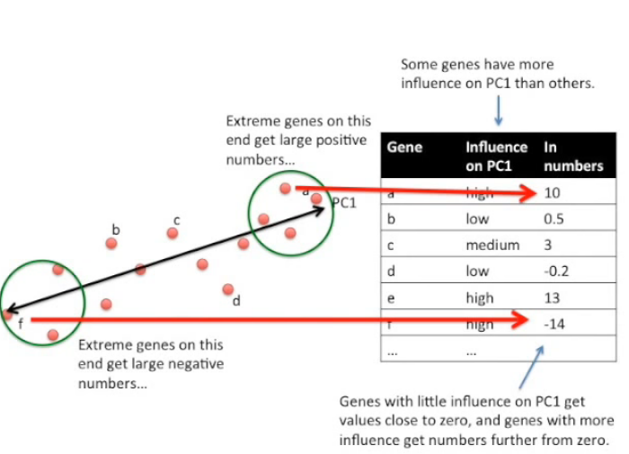

Slide 14
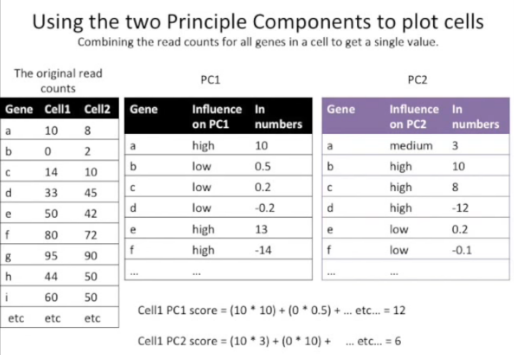

Slide 15
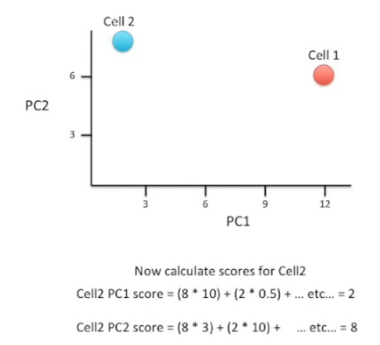
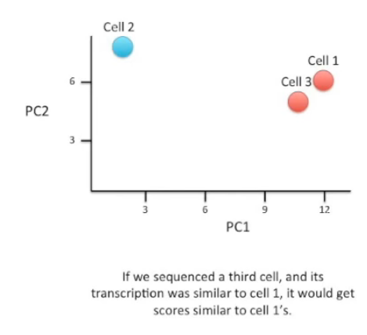

Slide 16
